Slide 2
Setting up Tiago development environment
Pull docker image
  Image download
    LINK: https://cloud.pal-robotics.com/s/MMRYi6zSTiQKLEa
    PASSWORD: 999TtcKC
    Link: https://cloud.pal-robotics.com/s/keLY6Nipz5KbZ7P
    Password: 9CcoeXAC
  bash unl-build-docker.sh
Run temporary docker container
  docker run -it --name tiago_pro_temp --env="DISPLAY=$DISPLAY" --volume="/tmp/.X11-unix:/tmp/.X11-unix:rw" --network host --gpus all development-tiago-pro-23:alum-edge
  exit
Copy files from temporary container to local machine
  Or docker cp tiago_pro_temp:/opt/pal/alum/share ~/workspace_holland_2026_01/pal_packages
Remove temporary container
  docker remove tiago_pro_temp

Slide 3
Setting up Tiago development environment
Start new docker container with local workspace
  docker run -it --name holland_01 --env="DISPLAY=$DISPLAY" --env="QT_X11_NO_MITSHM=1" -v "/tmp/.X11-unix:/tmp/.X11-unix:rw" -v "$HOME/workspace_holland_2026_01/pal_packages/share:/opt/pal/alum/share:rw" --network host --gpus all --privileged --device=/dev/bus/usb --device=/dev/snd -w /opt/pal/alum/share development-tiago-pro-23:alum-edge
Start docker
  docker start holland_01
  docker exec -it holland_01 bash
Or to reduce repetition
  echo "alias holland_01='docker exec -it holland_01 bash'" >> ~/.bashrc
  source ~/.bashrc
To allow local file manipulation from docker
  $ chmod -R a+rwx share inside local folder
Handle GUI Authorization Issue (if applicable)
  xhost +local:docker

Slide 4
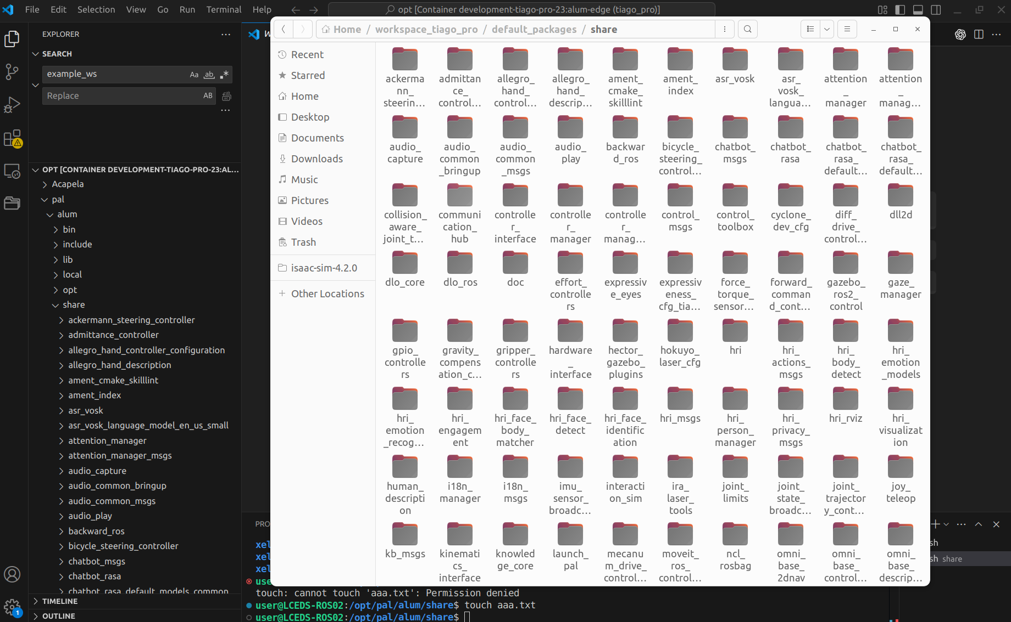
Setting up Tiago development environment
- Container (/pal/alum/share) and local folder (share) synchronized
- Syncing /opt overwrites /opt/ros/humble, where ROS2 is installed—so ros2 stops working.

Slide 5
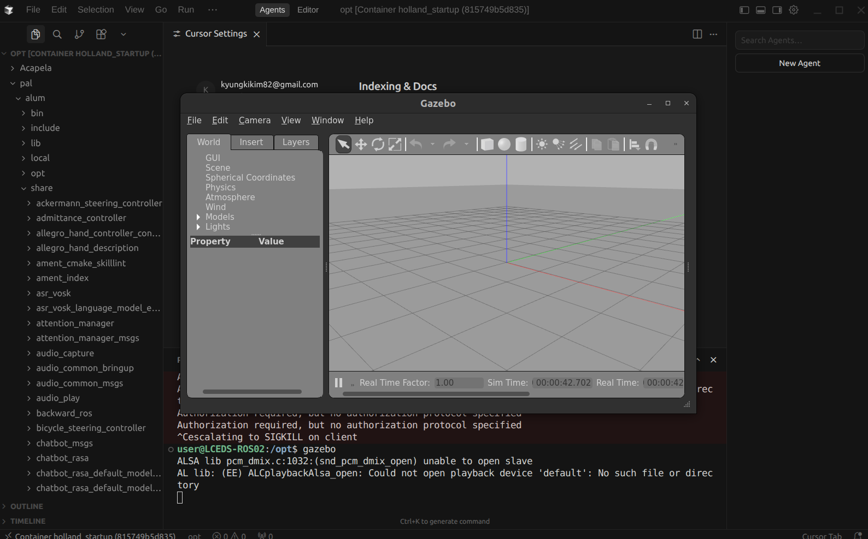
Test - Run Gazebo
Do this if Gazebo UI does not show up
xhost +local:docker

Slide 6
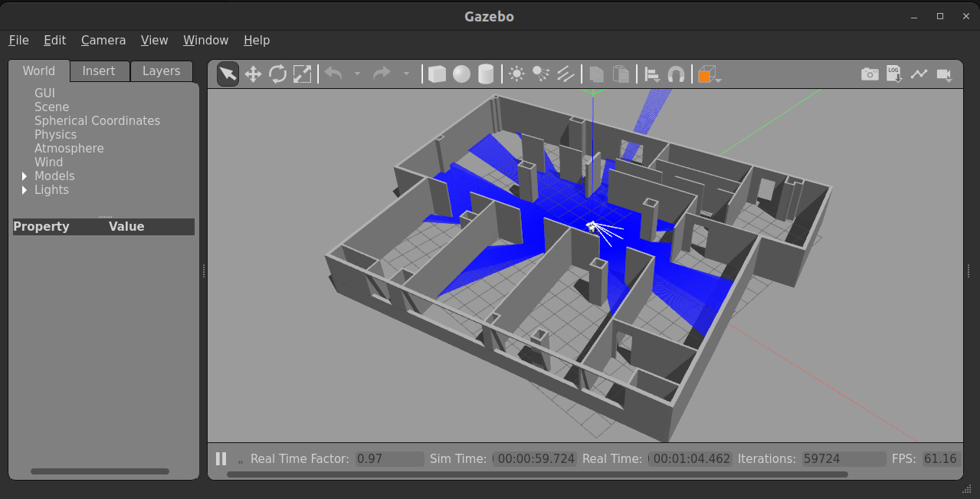
Gazebo sim
https://docs.pal-robotics.com/edge/general/getting-started-simulator#robots-simulation
$ ros2 launch tiago_pro_gazebo tiago_pro_gazebo.launch.py

Slide 7
Gazebo + Teleop
Adapt from Tiago 1 tutorial (https://wiki.ros.org/Robots/TIAGo/Tutorials/motions/key_teleop)
$ ros2 launch tiago_pro_gazebo tiago_pro_gazebo.launch.py
$ ros2 run key_teleop key_teleop

Slide 8
Gazebo + cmd_vel
$ ros2 launch tiago_pro_gazebo tiago_pro_gazebo.launch.py
$ ros2 topic pub /cmd_vel geometry_msgs/msg/Twist "{linear: {x: 0.1}, angular: {z: 0.0}}"
$ ros2 topic pub /cmd_vel geometry_msgs/msg/Twist "{linear: {x: 0.0}, angular: {z: 0.0}}"
$ ros2 topic pub -1 /cmd_vel geometry_msgs/msg/Twist "{linear: {x: 0.1}}" ; ros2 topic pub -1 /cmd_vel geometry_msgs/msg/Twist "{linear: {x: 0.0}}" (to move 1 tick)

Slide 10
Gazebo + 2D SLAM + Map saving
ros2 launch tiago_pro_gazebo tiago_pro_gazebo.launch.py navigation:=True slam:=True
ros2 run key_teleop key_teleop
ros2 run nav2_map_server map_saver_cli -f /opt/pal/alum/share/pal_maps/maps/practice_1/map

Slide 11
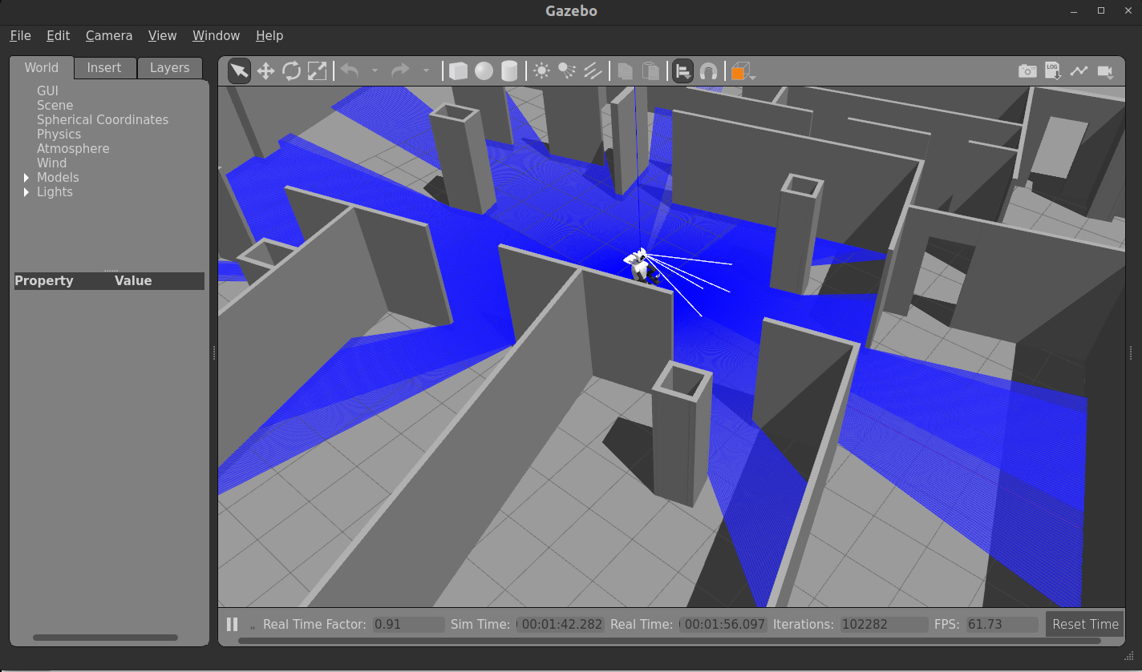
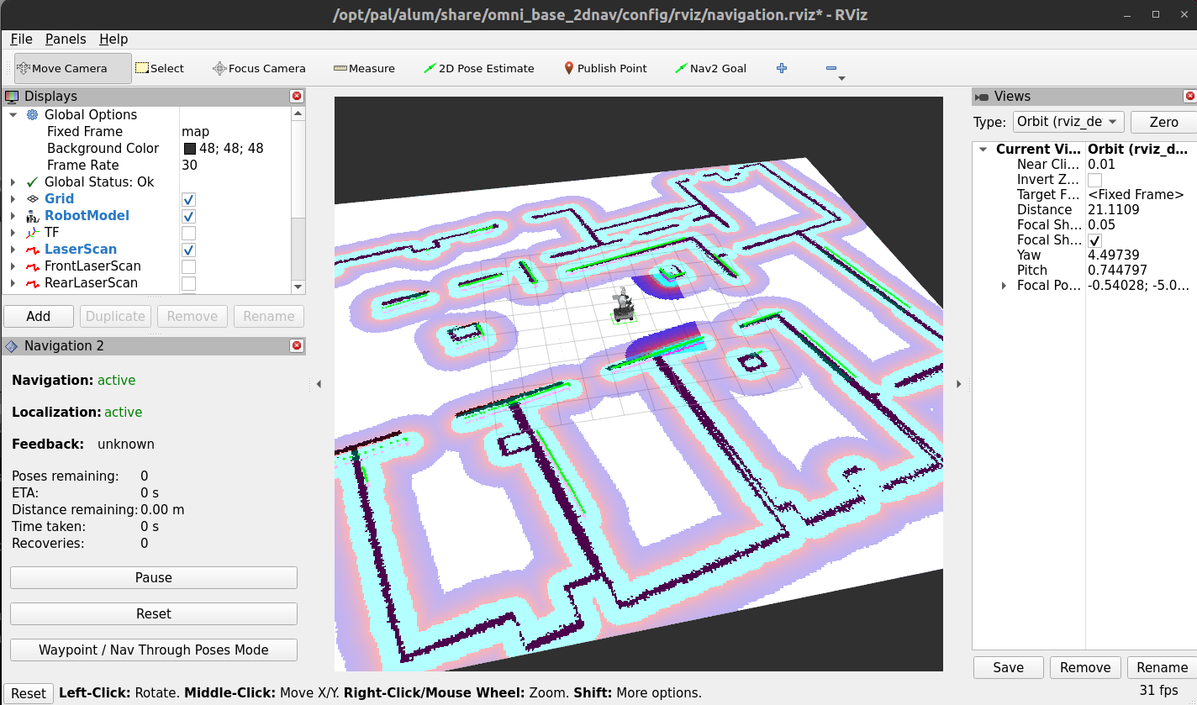
Test - Gazebo + Navigation
https://docs.pal-robotics.com/edge/general/getting-started-simulator#robots-simulation
$ ros2 launch tiago_pro_gazebo tiago_pro_gazebo.launch.py navigation:=True

Slide 12
Test - Gazebo + Navigation + Change Map
https://docs.pal-robotics.com/edge/general/getting-started-simulator#robots-simulation
ros2 launch tiago_pro_gazebo tiago_pro_gazebo.launch.py navigation:=True world_name:=small_office
ros2 service call /map_server/load_map nav2_msgs/srv/LoadMap "map_url: '/opt/pal/alum/share/pal_maps/maps/small_office/map.yaml'"

Slide 13
https://docs.pal-robotics.com/edge/development/rpk-tutorial#rpk-tutorial

Slide 14
Hello world (https://docs.pal-robotics.com/edge/development/basic-hello-world)
PAL interaction simulator (https://docs.pal-robotics.com/edge/development/interaction-simulator#interaction-simulator)
ROS4HRI (https://ros4hri.github.io/tutorials/interactive-social-robots/zero-to-llm.html)
rpk tutorial (https://docs.pal-robotics.com/edge/development/rpk-tutorial#rpk-tutorial)

Slide 15
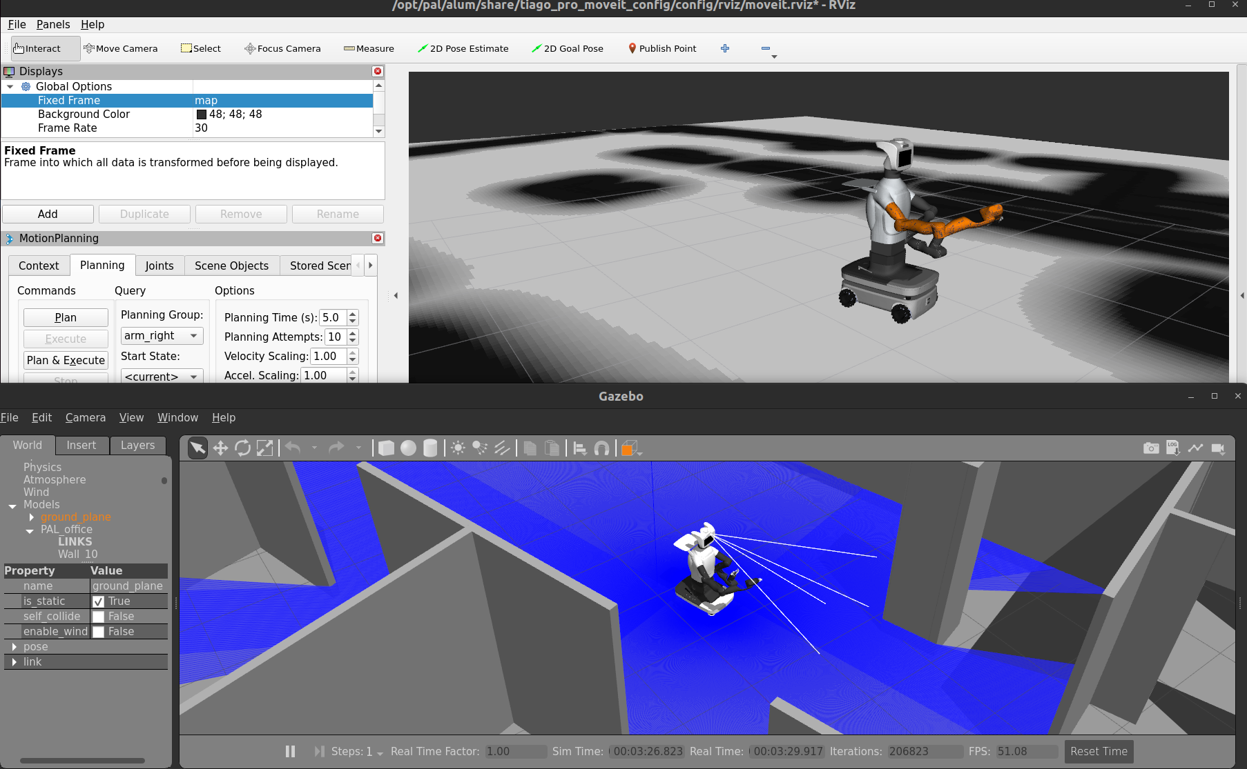
Gazebo Simulation
Run Gazebo without Rviz. Removed “actions.append(rviz_bringup_launch)” from tiago_pro_gazebo.launch.py
  ros2 launch tiago_pro_gazebo tiago_pro_gazebo_nav_motion.launch.py use_sim_time:=True navigation:=True
Run moveit_config
  ros2 launch tiago_pro_moveit_config moveit_rviz.launch.py use_sim_time:=True
All robot capabilities launched. Just need to add navigation topics to Rviz
Both navigation and motion planning enabled
Next step: implement openVLA here

Slide 18
Real Tiago Pro robot
MCP server running in docker
  pal connection start 10.68.0.1 wlx7419f816a4f8 2
  python3 holland_ai/simple_server.py
AI runtime outside docker
  python3 simple_agent.py
Frontend next to AI runtime
  workspace_holland_2026_01/holland-frontend/holland-voice-assistant---ver2$ npm run dev

Slide 19
Real Tiago Pro Robot - base movement
Move robot for a few seconds and stop (Publish velocity commands at 10Hz for the specified duration, then publish stop commands at 10Hz for 1 second to ensure the robot fully stops)
  timeout 3 ros2 topic pub /cmd_vel geometry_msgs/msg/Twist "{linear: {x: 0.1}}" -r 10; timeout 1 ros2 topic pub /cmd_vel geometry_msgs/msg/Twist "{}" -r 10

Slide 20
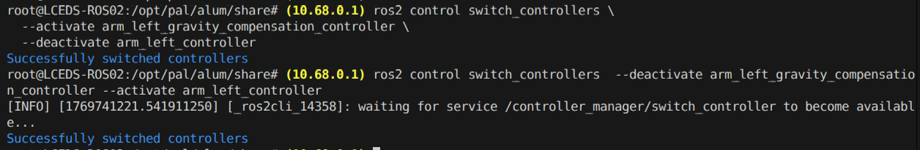
Real Tiago Pro Robot - gravity compensation mode
Gravity compensation - activation
  ros2 control switch_controllers --activate arm_left_gravity_compensation_controller --deactivate arm_left_controller
Gravity compensation - hold
  ros2 control switch_controllers --deactivate arm_left_gravity_compensation_controller --activate arm_left_controller

Slide 21
Real Tiago Pro Robot - robot listening and transcribing
Launch to start transcribing
  ros2 launch asr_vosk asr_vosk.launch.py
Echo result
  ros2 topic echo /humans/voices/anonymous_speaker/speech

Slide 22
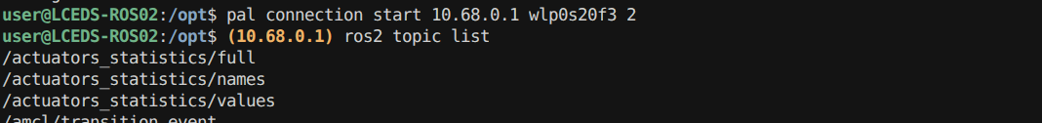
Connectivity: ROS 2 communication with robot (2026.01.15)
https://docs.pal-robotics.com/edge/development/robot-communication-ros2#robot-communication-ros2
Remote communication between robot and Tiago Pro docker
pal connection start [robot_address] [network_interface] [ros_domain_id]
pal connection start 10.68.0.1 wlx7419f816a4f8 2
Get network_interface
  ip a or ip route
Get robot_address
Get ros_domain_id

Slide 23
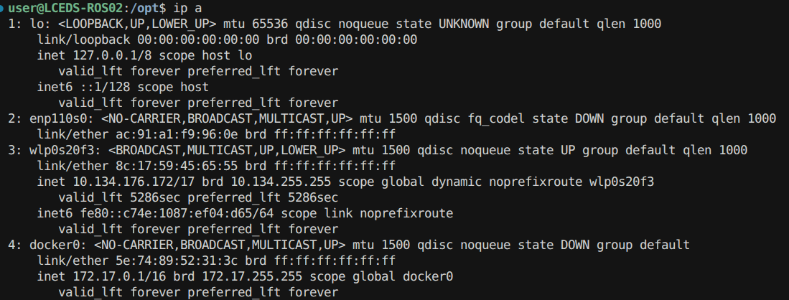
Connectivity: ip a and ip route from docker

Slide 24
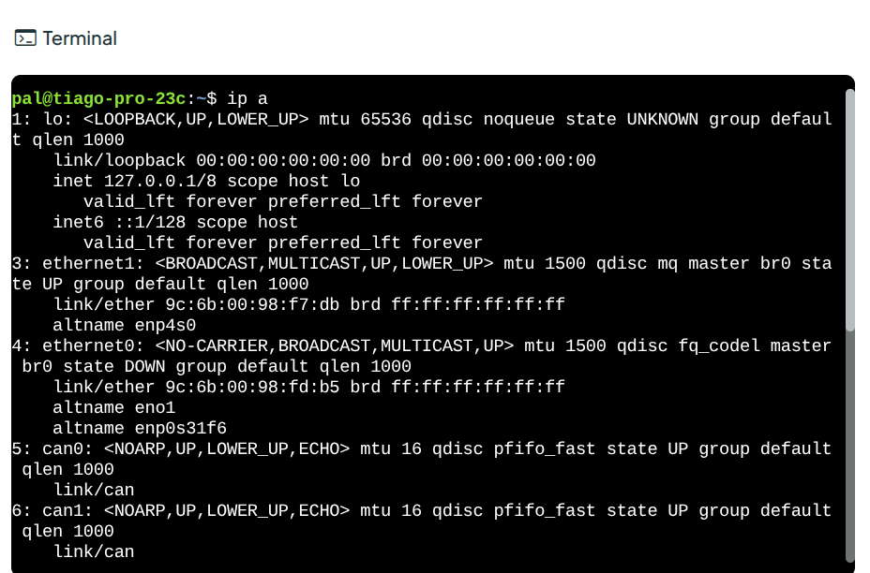
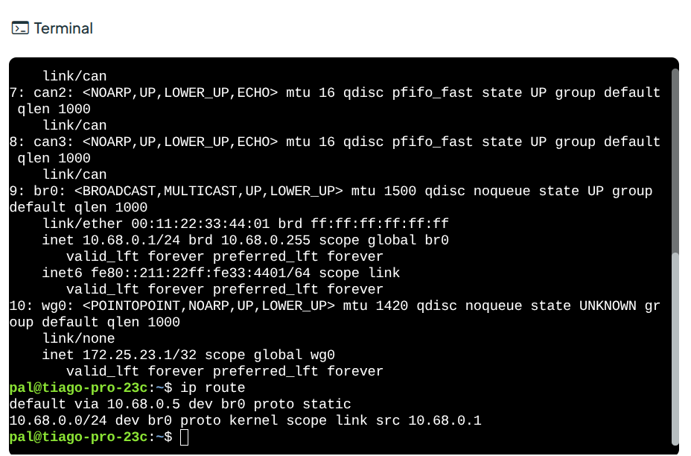
Connectivity: From robot web interface

Slide 25
Manipulation: Running Moveit Configuration
Moveit motion planning with RVIZ working. Sometime not stable
  ros2 launch tiago_pro_moveit_config moveit_rviz.launch.py
  Need to try defining new poses in Gazebo
D

Slide 26
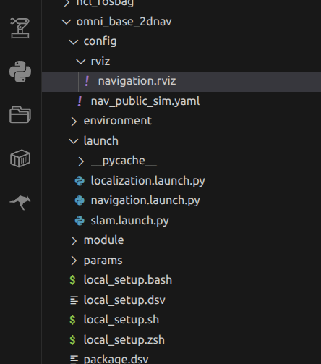
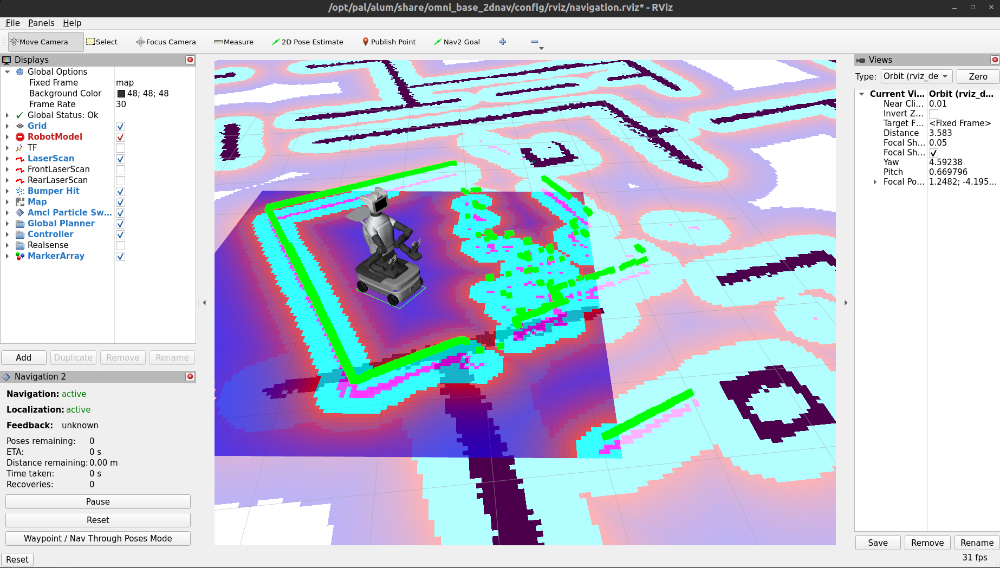
Navigation: simply running navigation

Slide 27
Speak skill
ros2 action send_goal /tts_engine/tts tts_msgs/action/TTS "{input: 'Hello! I am connected and ready to help.'}"

Slide 28
AI Agent: command-navigation-manipulation-conversation
To do list
  Gmapping. Simulation + real
  Speaking. Real
  After connecting to wifi, link to n8n
  Link to visualization

